Slide 1


Strings, Lists, Tuples, Sets, Dictionaries, Data Types, Variables, Naming conventions, Functions and conventions!
WELCOME
Meet up
PYTHON
Everything you need to start your own programming adventure

Slide 2
To get the slides, please use this URL:
https://tinyurl.com/vocd9zj
WELCOME
Meet up
PYTHON
Everything you need to start your own programming adventure

Slide 3


James Smith - CTO
Professional
2015 - Completed my PhD in Applied Mathematics
- Painlevé equations and Orthogonal Polynomials
2015 - 2017 - Lectured mathematics at the University of Kent
2017 - Joined Projecting Success
WELCOME
Meet up

Slide 4
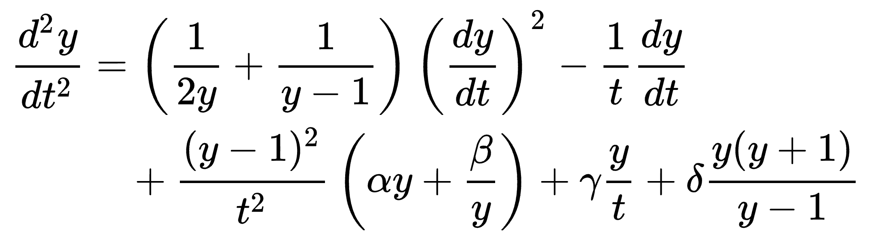
James Smith - CTO
Interests
Mathematics and modelling.
Machine learning – a genuine interesting In machine learning. I spend a lot time reading around the subject.
I am fascinated with computers and tech.
WELCOME
Meet up
5th Painlevé equation

Slide 5



Python
Python is a programming language
History:
Purpose and Use:
Python was created by Guido Van Rossum, and released in 1991
Python was inspired by C, Modula-3 and particularly ABC
Python gets its name from the "Monty Python's Flying Circus" commedy series
Python Software Foundation (PSF) takes care of Python's advances
Python emphasises productivity and code readability
Python is used by programmers that want to delve into data analysis or apply statistical techniques, and by developers that turn to data science
The closer you are to an engineering environment, the more preferable Python may be
CDING
BASICS
Meet up
Meet up

Slide 6

Google Colab
Google Colab is a free Jupyter notebook environment that requires no setup and runs entirely in the cloud
With Colab you can write and execute code, save and share your analyses, and access powerful computing resources, all for free from your browser
You can access Google Colab from here: https://colab.research.google.com/notebooks/
You can either create a new notebook, upload a notebook, or connect to a notebook saved in Google Drive or GitHub
CDING
BASICS
Meet up
Meet up

Slide 7
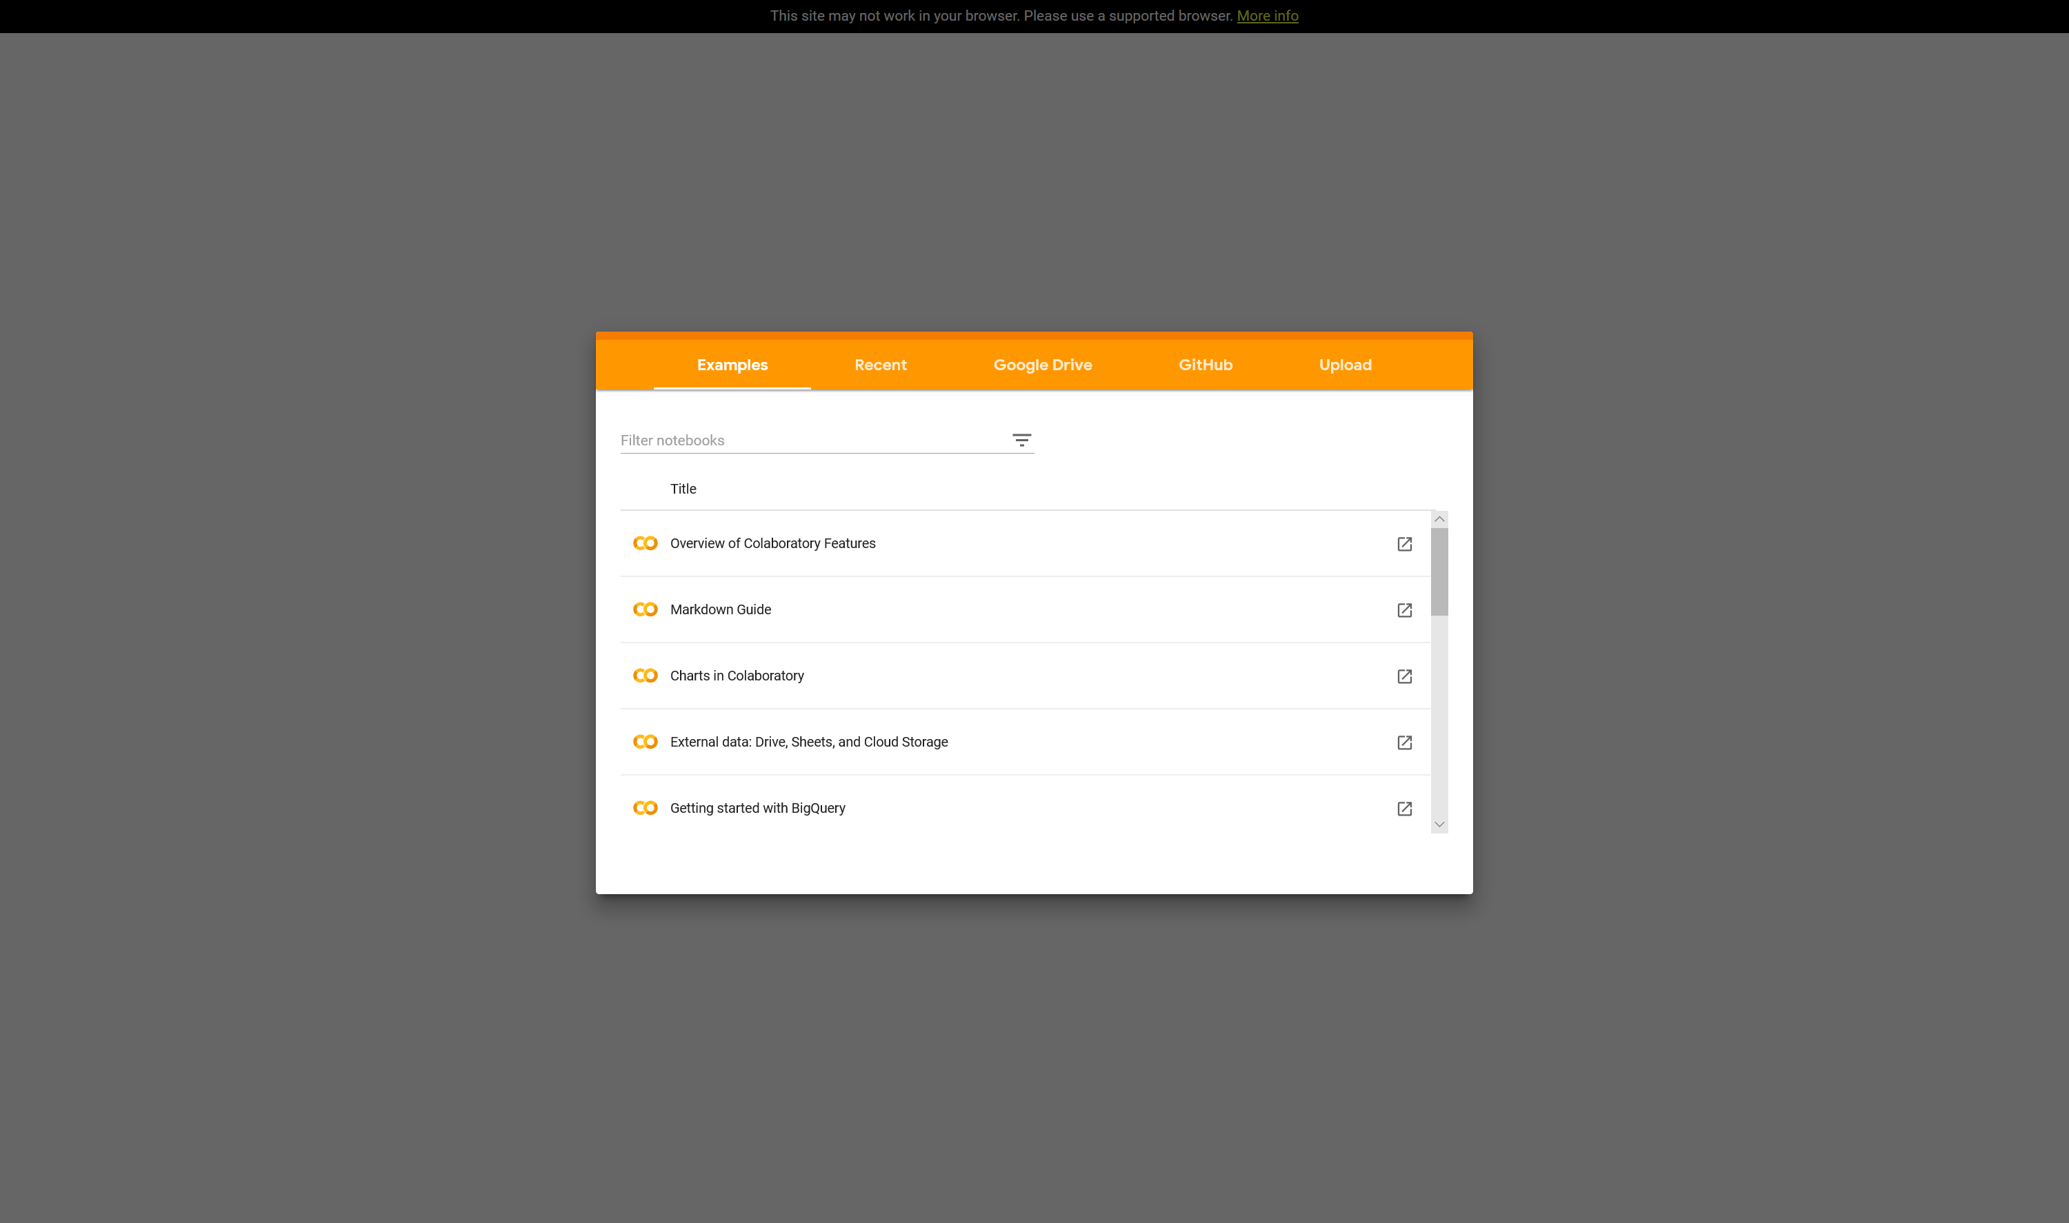
Google Colab
CDING
BASICS
Meet up
Meet up
Upload/ Connect to Files
Google Colab Notebook

Slide 8
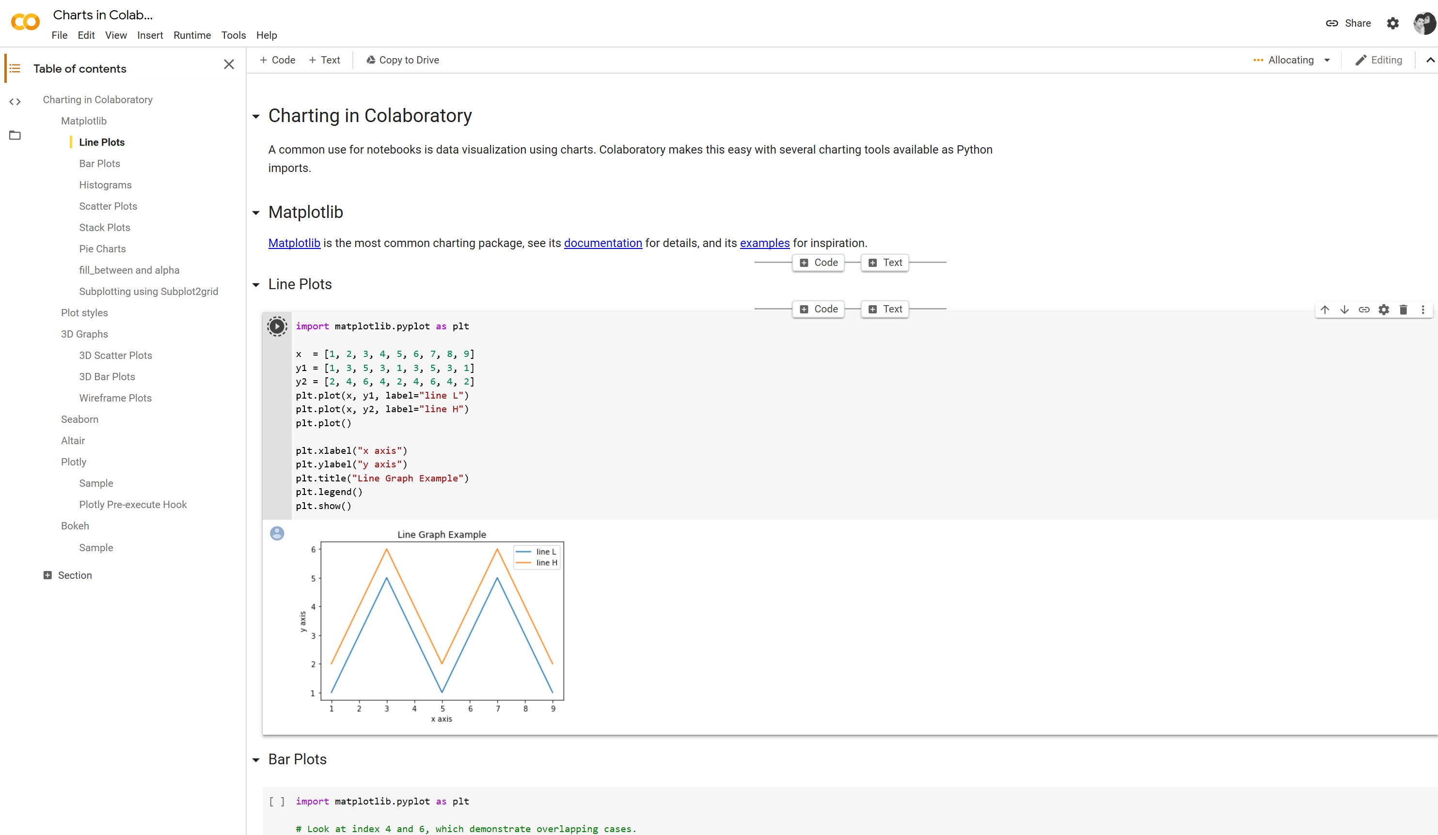
Google Colab
CDING
BASICS
Meet up
Meet up
Google Colab Notebook

Slide 9
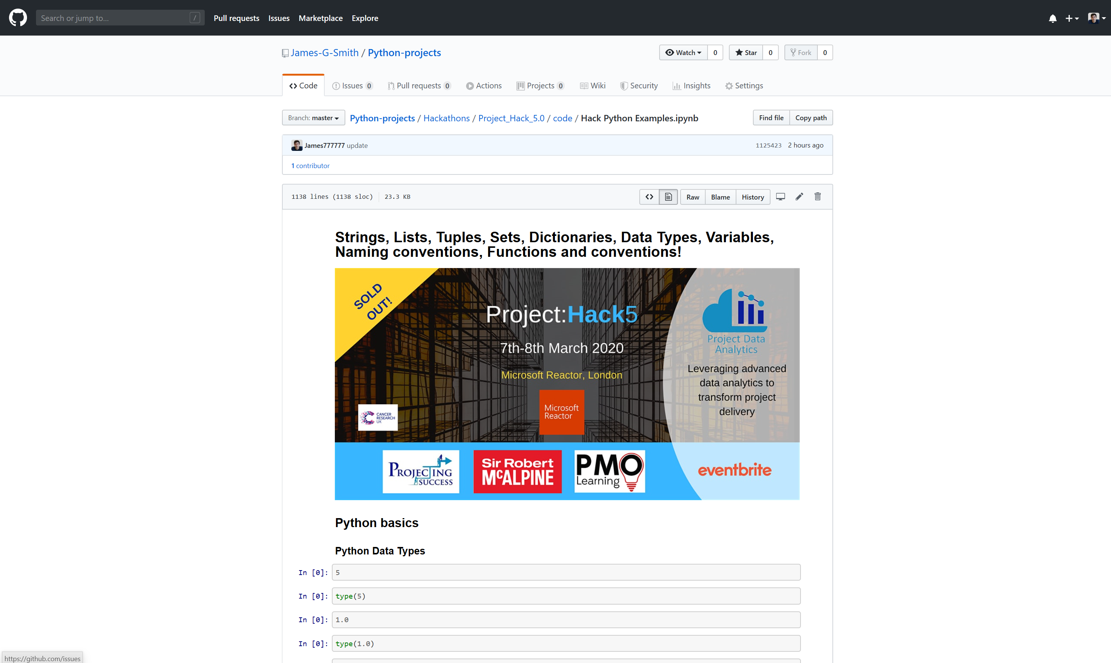

Connecting Google Colab to my Github
Who knows what GitHub is?!
CDING
BASICS
Meet up
Meet up
Copy this link
HINT: # means comment out.

Slide 10
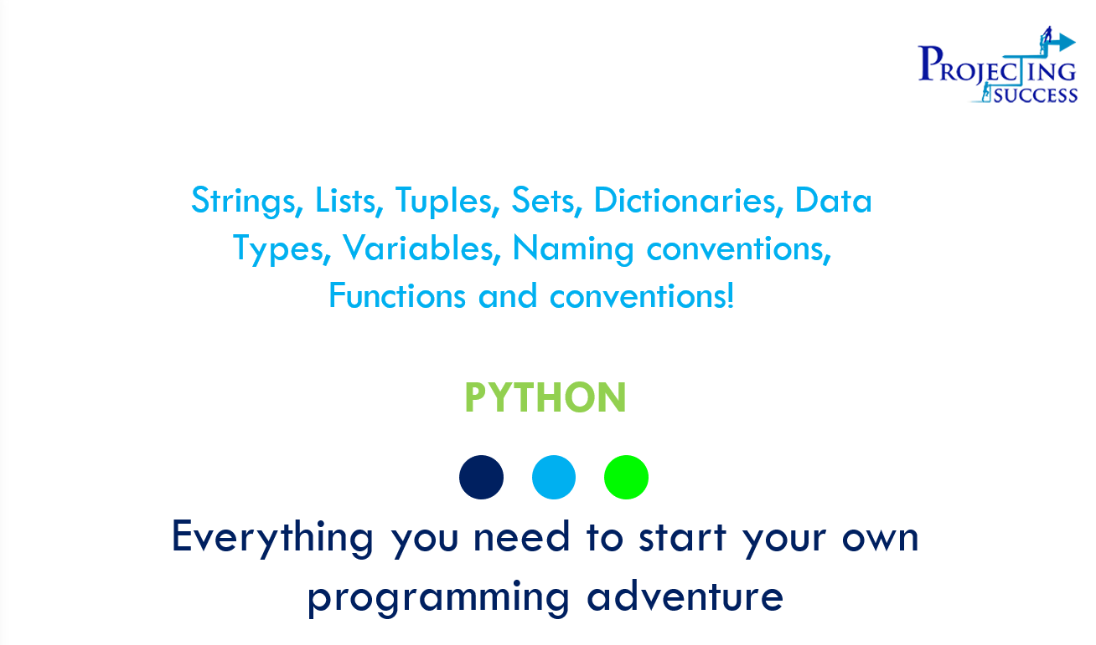
Everything you need to start your own programming adventure
Python Data Types
Variables, Naming Conventions & Print Function
String Operations
Procedures and Functions
BASICS
Meet up

Slide 11
Python Data Types
Number Operations
Boolean
Strings
Lists
Tuples
Sets
Dictionaries
BASICS
Meet up
Python Data Types

Slide 12
Python Data Types
Numbers in Python can be of three types:
Int: integers e.g. 5
1
Complex: complex numbers e.g. 4 + 5j
3
1
2
3
BASICS
Meet up
2
Float: floating point numbers e.g. 1.0
We can use the type() function to find out what class a variable or value belongs to
The isinstance() function allows us to check if a value or variable belongs to a certain class

Slide 13
Number Operations
Addition
Subtraction
BASICS
Addition of two numbers in Python is as we would expect e.g. 2 + 2 will give you the sum
An integer and a floating point number can be summed together. The output will be a floating point also
Subtraction of two number can be done easily: e.g. 5 – 1
An integer and floating point number can be substracted from one another. Again the output will be a floating point number
Meet up

Slide 14
Number operations
Multiplication
Division
BASICS
Two numbers in Python can be multiplied easily using the * operator, e.g. 5*4
An integer and a floating point number can be multiplied together, with the output a floating point number
Two numbers can be divided in Python using the / operator, e.g. 10/2
An integer and a floating point number can be divided together, with the output also a floating point number
Meet up

Slide 15
Boolean
In Python, a Boolean is an expression that can take two values, either True or False
Many functions and operation in Python return Boolean objects
The not keyword can be used to invert a Boolean type, e.g. not True is equivalent to False in Python
BASICS
Meet up
For example:
Consider x = 15
isinstance(x, int) returns True, isinstance(x,float) returns False

Slide 16
Strings
A string in Python is simply a sequence of characters, where characters are symbols (e.g. letters in the alphabet)
Computers don't deal with characters, only numbers, so although we see characters on the screen they are internally stored as binary numbers
Characters are converted to a number through a process called encoding. The reverse process is decoding
ASCII and Unicode are two of the popular encodings used, but we won't go in to these here
A string in Python is a sequence of Unicode characters
BASICS
Meet up
In Python, strings can be easily created by enclosing characters inside a quote
Either single or double quotes can be used
Sometimes triple quotes are used, however these are usually saved for multiline strings
"Hello", 'My String' and "It's sunny today" are all strings in Python
Later we will cover some general 'string operations'

Slide 17
Lists
A list in Python is a data type that involves the compounding of other data types
To create a list we place all the list items (elements) inside a pair of square brackets separated by commas
Lists can contain any number of items, even no items, and can contain data of different types (integer, float, string etc.)
A list can contain elements of mixed data types, they don't need to be of all the same type
BASICS
Meet up
For example:
[ ] - an empty list
[2, 5, 3, 9, 4] - a list containing only integers
["hello", 4, "hi", 9.7] - a list contained elements of mixed data types

Slide 18
Tuples
A Python tuple is similar to a list
The difference between the two is that tuples are immutable - we can't change the elements of a tuple once it has been assigned, whereas in a list the elements can be changed
A tuple is created by placing elements inside a set of parentheses () separated by commas
As with lists, tuples can contain any number of items and may contain data of different types
Tuples are often used to write-protect data and are usually faster than lists as they can’t change dynamically
BASICS
Meet up
Tuple examples:
(3, "Hi", 1) - a tuple of mixed data type
(1, 2, 3) - a tuple containing only integers

Slide 19
Sets
A set in Python is an unordered collection of items
Each element is unique (no duplicates are allowed), and it is immutable (elements can't be changed)
Sets are created by placing elements inside a set of curly braces, {}, or the built-in set() function, with elements separated by a comma
Sets can be used to perform mathematical set operations such as union, intersection etc.
Sets can have any number of items, and may contain data of different types
However sets can't contain mutable elements, such as lists
BASICS
Meet up
Set examples:
{3, 4, 5, 6}
set({3, 4, 5, 6})

Slide 20
Dictionary
A Python dictionary is an unordered collection of items, where each element is a key: value pair
Dictionaries are used to retrieve values when the key is known
Dictionaries are created by placing items inside a pair of curly braces, {}, with each item a key value pair of the form, 'key: value'. Each item is separated by a comma
Dictionaries can also be created using the built in dict() function
BASICS
Meet up
Dictionary examples:
{1: 'apple', 2: 'banana', 3: 'orange'} - a dictionary with integer keys
{'a': 'apple', 'b': 'banana'} - a dictionary with string keys
{1: 'apple', 'b': 'banana'} - a dictionary with mixed key types

Slide 21
Variables, Naming Conventions & Print Function
Variables
Naming conventions
Print Function
BASICS
Variables, Naming
Conventions & Print Function
Meet up

Slide 22
Variables
Variables are used in Python as containers for storing data values
Python has no command for declaring a variable, a variable is created the moment a value is first assigned to it
We are not required to set the data type of a variable, and the data type can change as the variable changes (e.g. from integer to float)
Variable Rules
Variables must start with a letter or with the underscore character, a variable name can't start with a number
Variable names can only contain alpha-numeric characters and underscores
Variable names are case-sensitive, x and X are different variables
BASICS
Meet up
Variable Examples:
X = 7
Name = "Bob"
_weather = 'It is sunny today'

Slide 23

Naming conventions
Coding standards and naming conventions are an important set of rules to follow in order to produce maintainable and scalable code
The coding standards used in Python are explained in Python's PEP8 documentation
The naming conventions include variable names, package names, module names and class names
Naming conventions are just one part of the Python coding standards, more information can be found in the documentation here
BASICS
Meet up

Slide 24


Naming conventions
General
Don't use names that are too general or too wordy, maintain a fine balance between the two
1
Bad variable names: user_list, moveInts, swapNums, dict_to_store_defns_of_a_word
BASICS
Meet up
3
Good variable names:
user_info, move_integers, swap_numbers, word_definitions
Things to note:
don’t be naive and name things like “X,” “Y” or “Z”
2

Slide 25
Print Function
BASICS
The print() function is one of the most important and commonly used functions in Python
It is a built-in function
If we have a variable, x, to print out its value we simply call print(x)
We can also use the print function directly with data, e.g. print("Hello") will return the string
Meet up

Slide 26
String Operations
BASICS
String
Operations
Built-In string functions
String slicing
Meet up

Slide 27
String Operations
BASICS
Python has many methods for performing tasks to string objects, we will cover some of the most common operations here
There are many types of operations we can perform to a string, e.g. capitalisation, find the length, split a string etc.
We will first cover the important built-in string operation functions
Meet up
10.35

Slide 28
Built-In string functions
For the following functions assume string is a string variable
string.lower() - function that returns the lowercased string of the input string
string.upper() - function that returns the uppercased string of the input
string.capitalize() - function that returns the string with the first letter capitalised
string.strip() - function that returns the string with leading and trailing white space stripped
string.split([separator]) - function that splits a string based on the separator character. If no separator is given, the function will split on any whitespace
BASICS
Meet up

Slide 29
String slicing
As well as taking a single character from a string, we can also call a range of characters, or a slice
To slice a string, we create a range of index numbers separated by a colon, e.g. [x:y]
Consider the same string, name = "John"
name[0:2] = "Jo"
If we want to include either end of the string, we can omit one of the index numbers, e.g. name[:2] = name[0:2]
name[1:] = "ohn"
BASICS
Meet up
Character: | J | o | h | n
Index: | 0 | 1 | 2 | 3
Reverse Index: | -4 | -3 | -2 | -1

Slide 30
String slicing
Exercise
Print out ALL but the last two letters of “John”
BASICS
Meet up

Slide 31
String slicing
Solution
name[:-2]
BASICS
Meet up

Slide 32
Procedures and Functions
Procedures
Functions
Exercise: The Fibonacci Sequence
BASICS
Procedures
And
Functions
Meet up

Slide 33
Procedures
Procedure - If the same piece of code needs to be used several times we can use a loop - but only if those times are all together. If you need to run the same bit of code again later, you can use a procedure.
Example - print the squares of the numbers from 1 to 20:
BASICS
#This is a procedure called output
#It will print a given number and its square
def output(number):
print(number,"squared =",number*number)
#This is the start of the main program
output(8)
Meet up
Try a few more!

Slide 34
Procedures
Optional Parameters
Once you have defined a procedure, you can call it in a number of ways:
You can pass as many (or few) of the parameters as you like - as long as they’re in the right order. This means you have to plan the procedure quite carefully.
BASICS
def output(grade,score=50,feedback="Well done!"):
print("You scored",score,"which is a grade",grade,feedback)
output("C")
output("A",87)
output("E",12,"Rubbish!")
Meet up

Slide 35
Functions
Procedures that return something are called functions.
In Python a function is some reusable code that takes arguments(s) as input does some computation and then returns a result or results
We define a function using the def reserved word
We call/invoke the function by using the function name, parenthesis and arguments in an expression
BASICS
Meet up
def calculate(number):
newnumber = number / 100
return (newnumber)
calculate(6400)

Slide 36


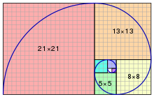
The Fibonacci Sequence
BASICS
Meet up
It is the sequence 0, 1, 1, 2, 3, 5, 8, 13, 21, 34,…
The next number is calculated by adding up the two numbers before it.
Fibonacci numbers are strongly related to the golden ratio.
x₀ = 0, x₁ = 1, x_{n} = x_{n-1} + x_{n-2,}

Slide 37
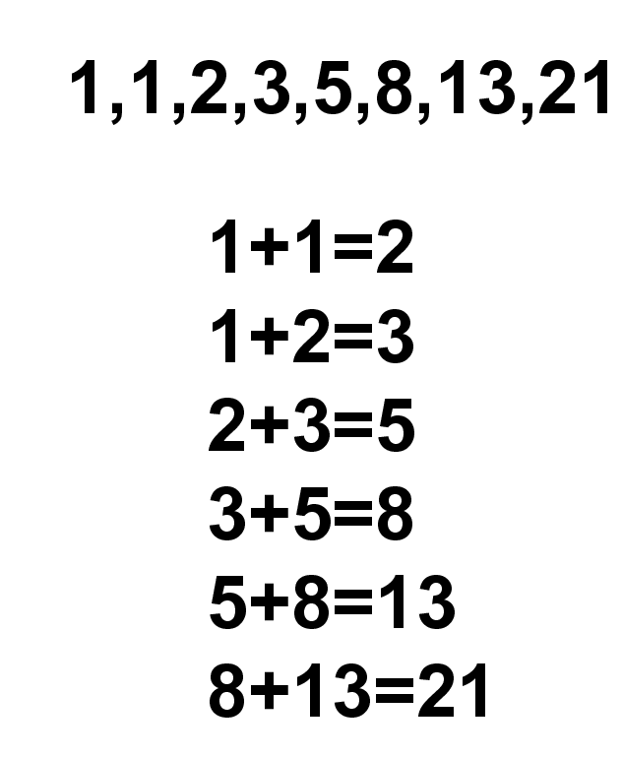
The Fibonacci Sequence
BASICS
Create a function that is able find any nth number in the Fibonacci sequence.
Find the 10th number in the sequence
Find the 35th number in the sequence
Meet up

Slide 38
The Fibonacci Sequence
Solution
def fibonacci(n):
if n == 1 or n == 2:
return 1
else:
return (fibonacci(n - 1) + (fibonacci(n - 2)))
BASICS
Meet up

Slide 39
Fun Coding Examples
Calculate number of upper/lower case letters in string
def string_test(s):
d={"UPPER_CASE":0, "LOWER_CASE":0}
for c in s:
if c.isupper():
d["UPPER_CASE"]+=1
elif c.islower():
d["LOWER_CASE"]+=1
else:
pass
print ("Original String : ", s)
print ("No. of Upper case characters : ", d["UPPER_CASE"])
print ("No. of Lower case Characters : ", d["LOWER_CASE"])
string_test('The quick Brown Fox')
BASICS
Meet up

Slide 40
Fun Coding Examples
def caesar_encrypt(realText, step):
outText = []
cryptText = []
uppercase = ['A', 'B', 'C', 'D', 'E', 'F', 'G', 'H', 'I', 'J', 'K', 'L', 'M', 'N', 'O', 'P', 'Q', 'R', 'S', 'T', 'U', 'V', 'W', 'X', 'Y', 'Z']
lowercase = ['a', 'b', 'c', 'd', 'e', 'f', 'g', 'h', 'i', 'j', 'k', 'l', 'm', 'n', 'o', 'p', 'q', 'r', 's', 't', 'u', 'v', 'w', 'x', 'y', 'z']
for eachLetter in realText:
if eachLetter in uppercase:
index = uppercase.index(eachLetter)
crypting = (index + step) % 26
cryptText.append(crypting)
newLetter = uppercase[crypting]
outText.append(newLetter)
elif eachLetter in lowercase:
index = lowercase.index(eachLetter)
crypting = (index + step) % 26
cryptText.append(crypting)
newLetter = lowercase[crypting]
outText.append(newLetter)
return outText
code = caesar_encrypt('abc', 2) #the letters 'a' 'b' 'c' are 2+ what their orignal value is so becomes 'c' 'd' 'e'
print()
print(code)
print()
Ceaser Cypher
BASICS
Meet up

Slide 41
Fun Coding Examples
Inputs
BASICS
Meet up
first_name = input("Welcome to the hack! \nWhat is your first name? \n")
surname = input("What is your surname?\n")
full_name = first_name + " " + surname
print ("Good to have you onboard " + full_name)

Slide 42

Thanks for your time!
Any questions?!
BASICS
Meet up

Slide 43
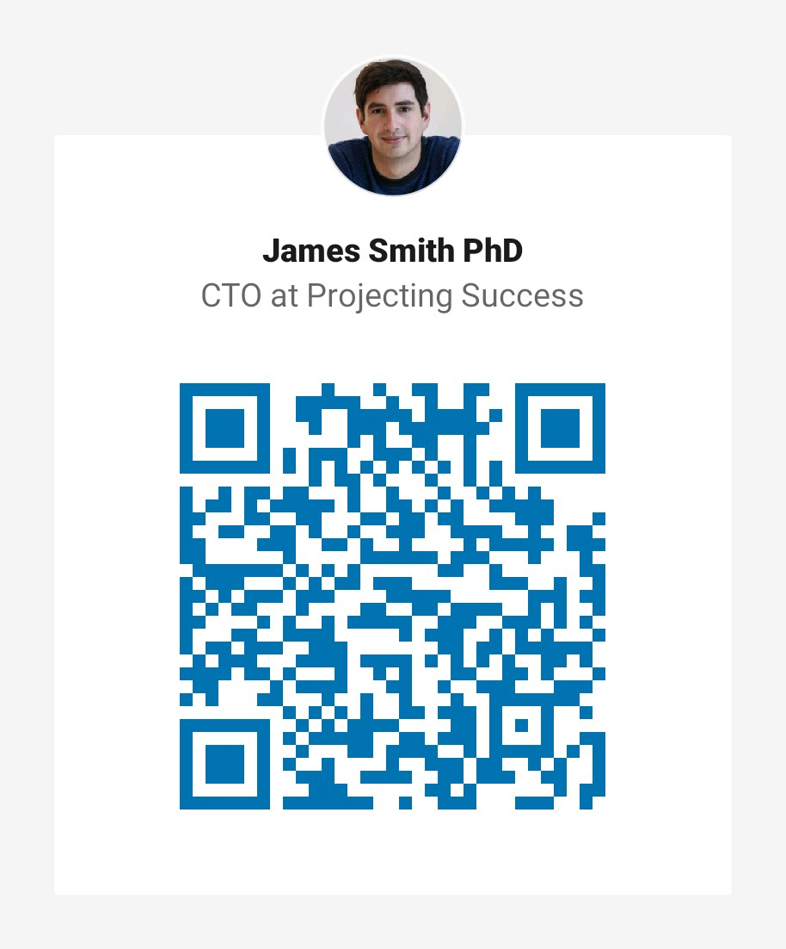

Thanks for your time!
Any questions?!
BASICS
Meet up
Please find me on Linkedin
Dr James Smith
CTO
www.projectingsuccess.co.uk
Jamessmith@projectingsuccess.co.uk
+44 7891805279

